Slide 1
ONLINE BOOKSTORE

Slide 2
OVERVIEW
Book Store Management web application using Spring Boot,MySql,Angular
In this project we can view list of books available in bookstore and we can add books ,update books and delete books

Slide 3
Spring Boot:
Spring Boot is a tool that makes developing web application and microservices with Spring Framework faster and easier.

Slide 4
Spring Boot Flow Architecture
Client
Controller
Service
Repository
Database

Slide 5
Dependency we need
1.Spring Web
2. Spring Data JPA
3.MySql Database
4. Devtools

Slide 6
Technologies we used:
1.Spring Boot
2.MySql database
3.Angular

Slide 7
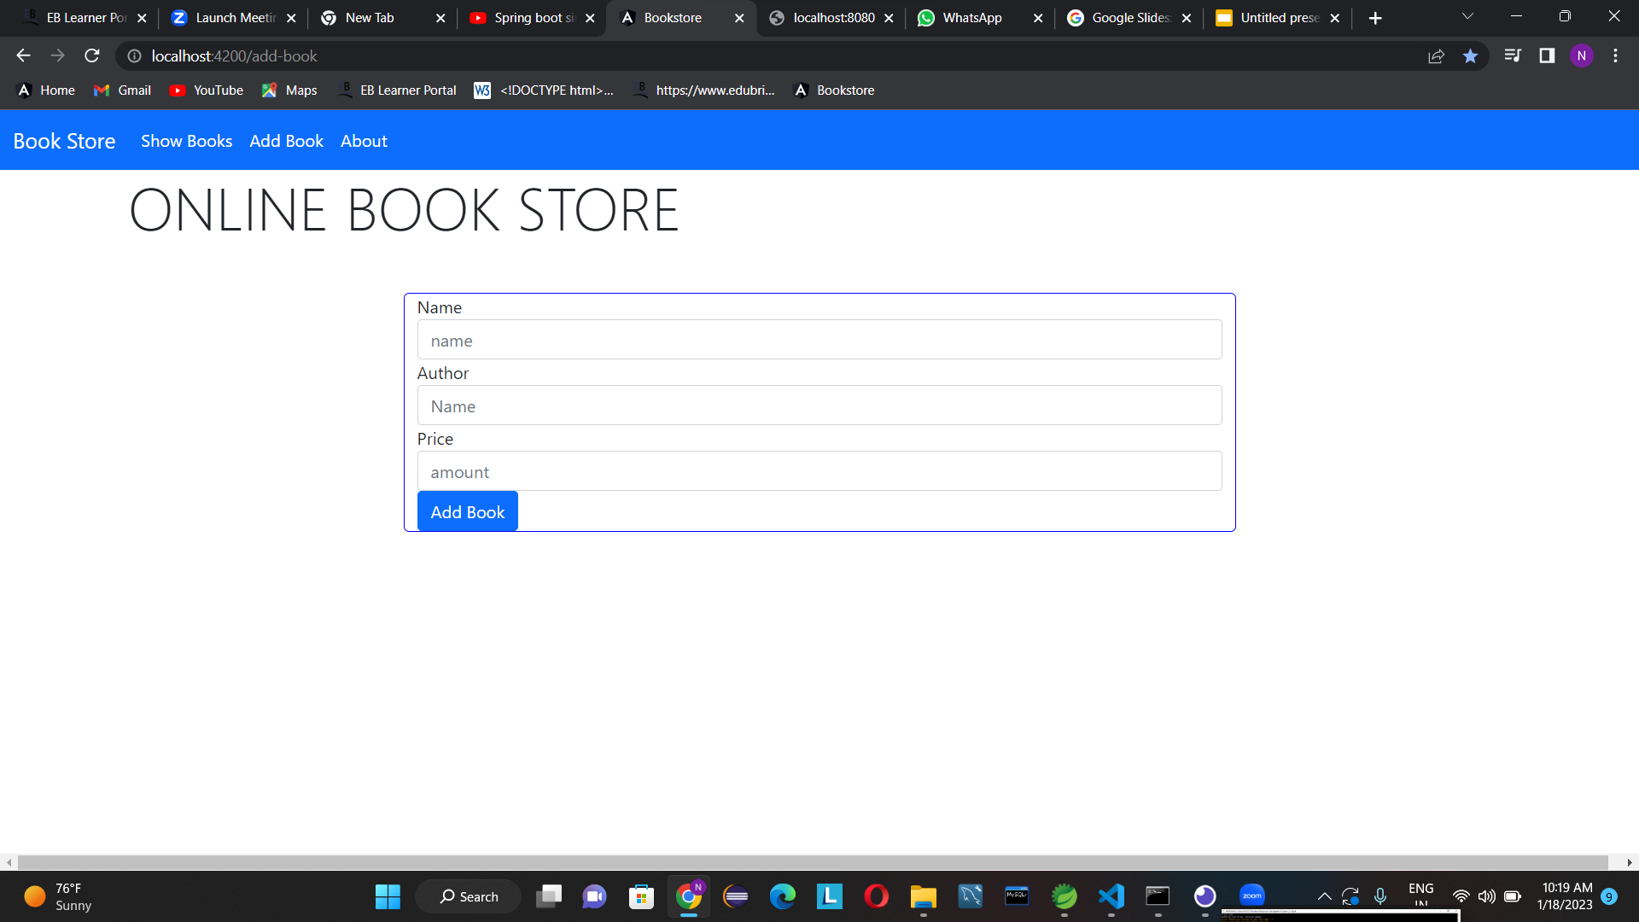

Slide 8
THANK YOU

